Slide 1
Background
In Japan dealers, there are many parts, labor codes existing in LDS. It is difficult for people working in the workshop to memorize the part numbers, codes, etc. Maybe we could use machine learning to see if there are any patterns with the order line details, then machine could suggest mechanics what parts, labors are required for an order.

Slide 2
Suggestions
In Japan UD, customers and mechanics usually put detailed descriptions(or information) of the work into order notes, line description, etc. We could use machine learning, basing on the orders in history, to train a model for prediction. Once we have this model, customers and mechanics just need to describe the problems and work, then the trained model will suggest what parts, labor, etc should be included in that order.

Slide 3

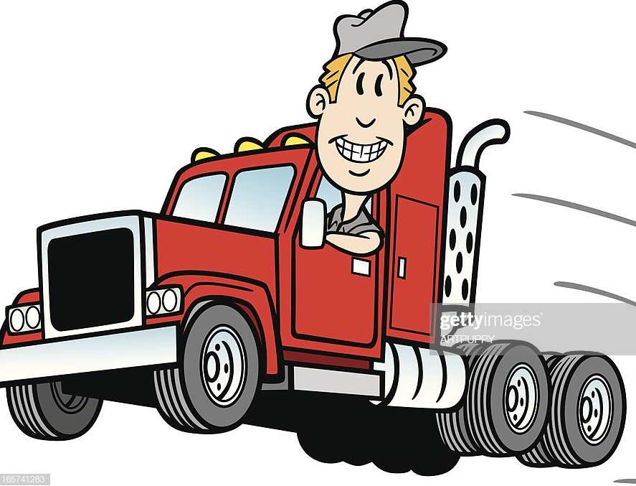
Suggestions
I need a regular check
Filter need to clear
Fuel tank need to be changed
LDS
Order XXXX is created, with part xxxx, standard time xxxx

Slide 4
Future work
To make the model more precise in future, more data from other sources could be helpful, e.g. telematics, Azure AppInsight data pool. All these data will help the model learn better of the customer behaviors, etc.
To work well with more data, it is better to setup a big data platform to collect data and train Machine learning models in real-time. Hence, better computation power will be required(e.g. better server)

Slide 5
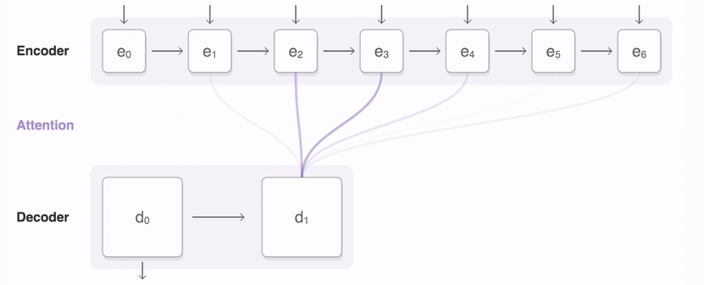
Seq2Seq(Confidence(notes))
Regular
three
month
basic
vehicle
check
<end>
Part 10506
SDT 001

Slide 6
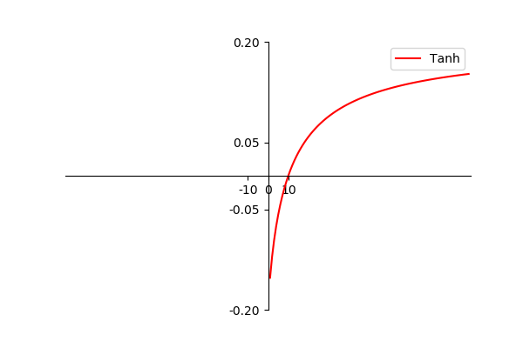

Confidence
$\text{Confidence}$ = Confidence(notes) + Confidence(lineId, Chassis)
Confidence(lineId, Chassis) = tanh(log(frenqency(lineId, Chassis) - Threshold))

